Slide 1
Chapter 15: Integrated Circuit Technologies

Slide 2
Objectives
After studying this chapter, students should be able to:
Component Analysis: Calculate noise margin, power dissipation, propagation delay, and performance.
Using Datasheets: Read technical specs, understand fan-out and TTL/CMOS gate operation.
TTL vs CMOS Comparison: Distinguish totem-pole vs open-collector outputs, compare performance.
Circuit Connection Techniques: Apply wired-AND, handle unused inputs, and understand tri-state logic.
CMOS Protection: Prevent damage from electrostatic discharge (ESD).

Slide 3
Contents
15.1. Basic Operational Characteristics and Parameters 15.2. CMOS Circuits 15.3. TTL (Bipolar) Circuits 15.4. Practical Considerations in the Use of TTL 15.5. Comparison of CMOS and TTL Performance 15.6. Emitter-Coupled Logic (ECL) Circuits 15.7. PMOS, NMOS, and E²CMOS

Slide 4
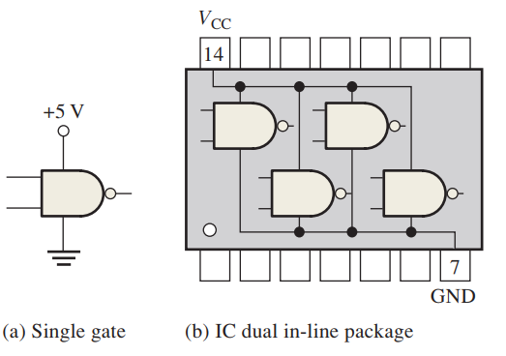
15.1. Basic Operational Characteristics and Parameters
DC Supply Voltage

Slide 5
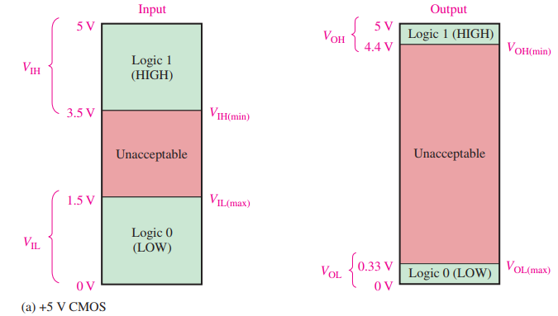
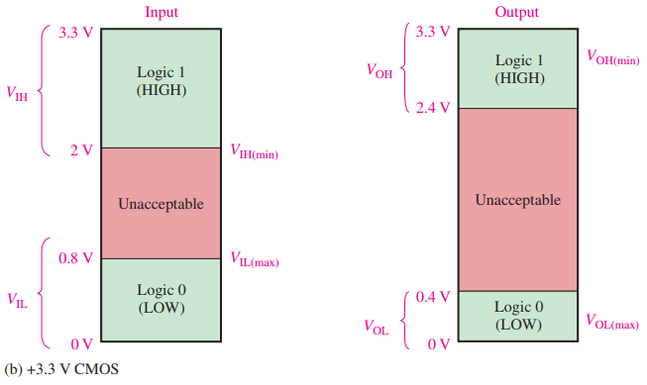
15.1. Basic Operational Characteristics and Parameters
CMOS Logic Levels CMOS gates operate reliably only when input voltages are within valid logic level ranges.

Slide 6
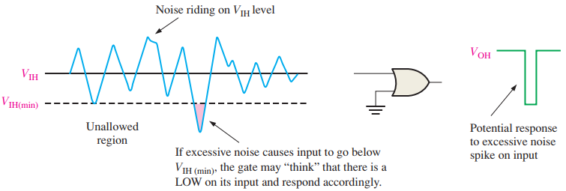
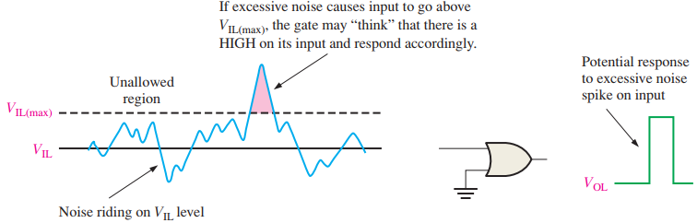
15.1. Basic Operational Characteristics and Parameters
Noise Immunity in Digital Circuits The circuit's ability to tolerate a certain amount of unwanted voltage without malfunction.
Key to ensuring stable HIGH (1) and LOW (0) logic levels.
FIGURE 15–4 Illustration of the effects of input noise on gate operation.

Slide 7

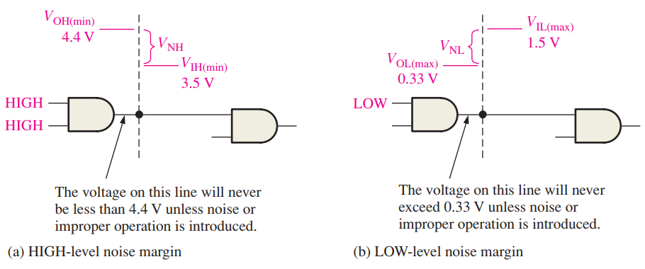
15.1. Basic Operational Characteristics and Parameters
Noise Margin

Slide 8

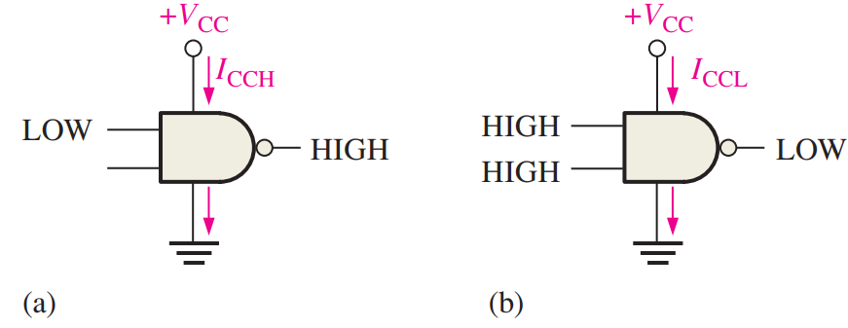
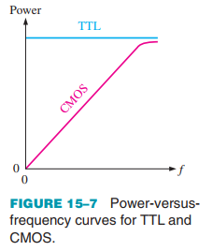


15.1. Basic Operational Characteristics and Parameters
Power Dissipation

Slide 9
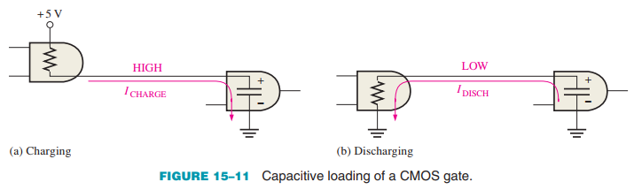
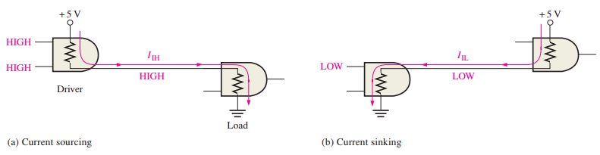
15.1. Basic Operational Characteristics and Parameters
CMOS Loading
TTL Loading

Slide 10
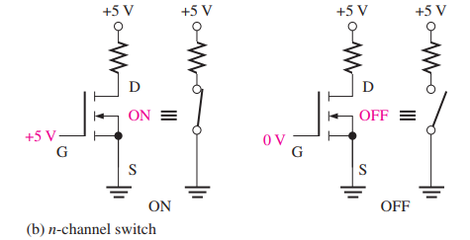
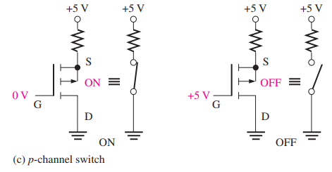
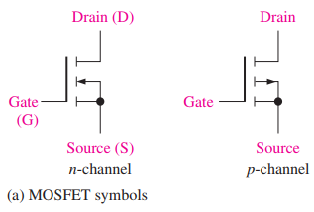
15.2. CMOS Circuits
The MOSFET A MOSFET is a type of field-effect transistor used as an active switch in CMOS circuits.
It acts like an open or closed switch, depending on the input voltage.
Replaces bipolar transistors (used in TTL circuits) in most modern digital systems.

Slide 11
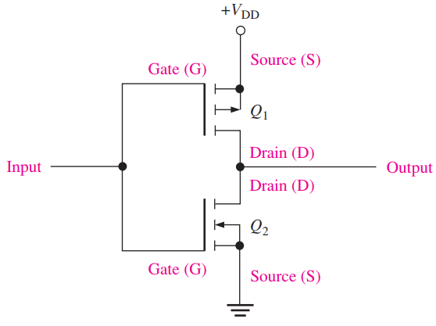
15.2. CMOS Circuits
CMOS Inverter Complementary MOS (CMOS) logic uses the MOSFET in complementary pairs as its basic element.

Slide 12
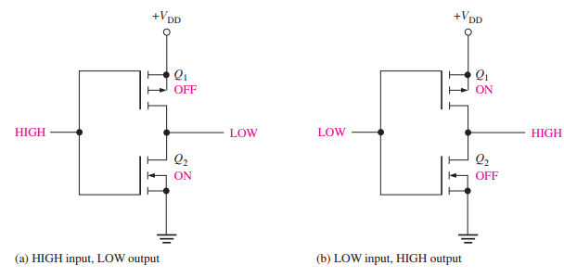

15.2. CMOS Circuits
CMOS Inverter Complementary MOS (CMOS) logic uses the MOSFET in complementary pairs as its basic element.

Slide 13
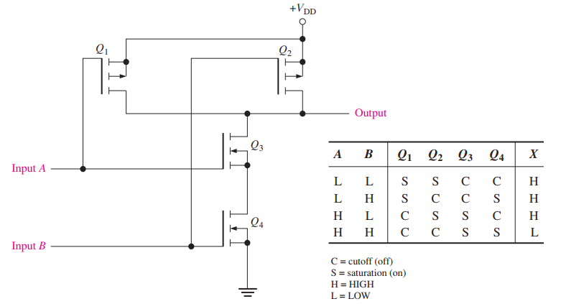
15.2. CMOS Circuits
CMOS NAND Gate

Slide 14
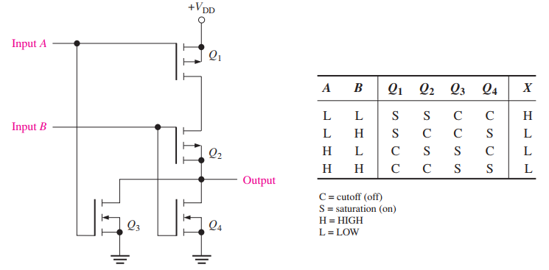

15.2. CMOS Circuits
CMOS NOR Gate

Slide 15
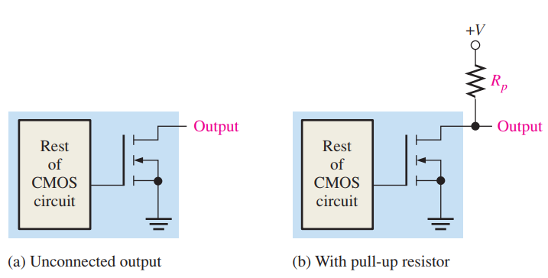
15.2. CMOS Circuits
Open-Drain Gates
In CMOS, open-drain means the drain terminal of the output transistor is left unconnected internally. It requires an external connection to VDD through a load (typically a pull-up resistor).

Slide 16
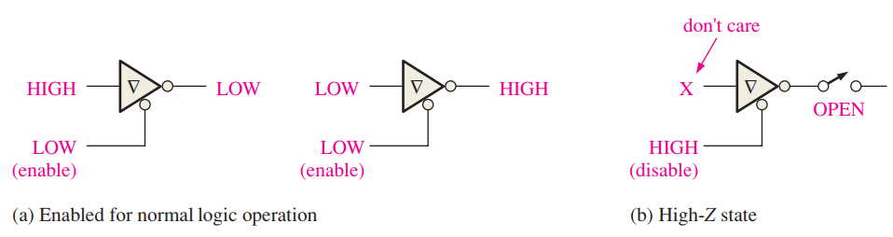
15.2. CMOS Circuits
Tri-state CMOS Gates Useful for bus systems where multiple devices share a common line, but only one drives the signal at a time.

Slide 17
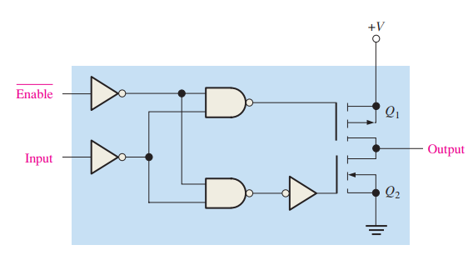
15.2. CMOS Circuits
Precautions for Handling CMOS All CMOS devices are subject to damage from electrostatic discharge (ESD). Therefore, they must be handled with special care.

Slide 18
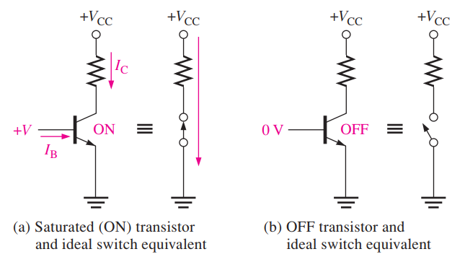
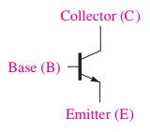

15.3. TTL (Bipolar) Circuits
The Bipolar Junction Transistor The bipolar junction transistor (BJT) is the active switching element used in all TTL circuits.

Slide 19
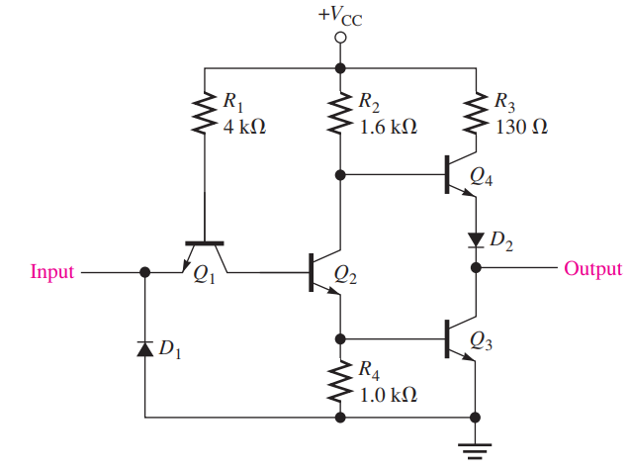
15.3. TTL (Bipolar) Circuits
TTL Inverter The logic function of an inverter or any type of gate is always the same, regardless of the type of circuit technology that is used

Slide 20
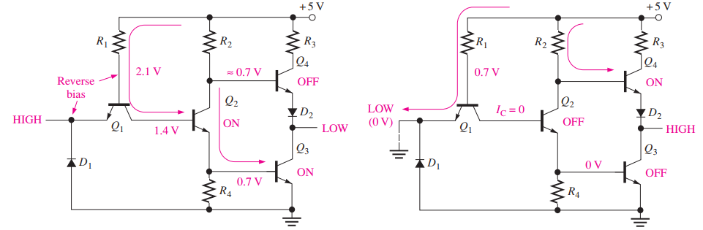

15.3. TTL (Bipolar) Circuits
TTL Inverter Operation of a TTL inverter

Slide 21
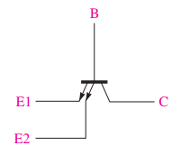
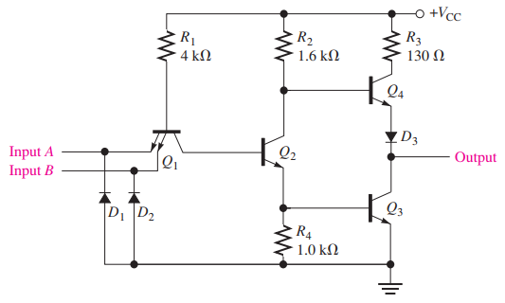
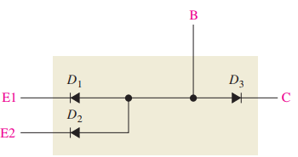

15.3. TTL (Bipolar) Circuits
TTL NAND Gate

Slide 22
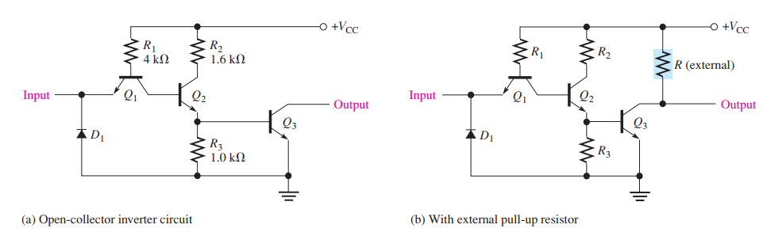
15.3. TTL (Bipolar) Circuits
Open-Collector Gates

Slide 23
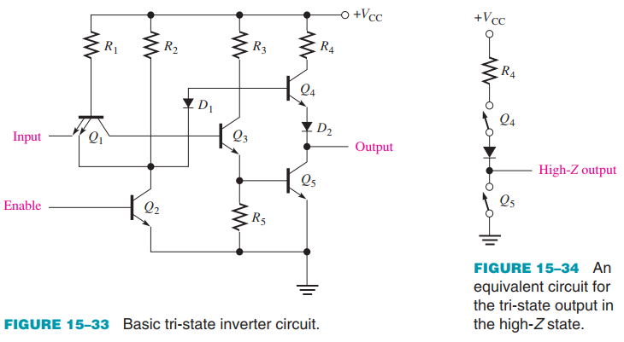
15.3. TTL (Bipolar) Circuits
Tri-state TTL Gates

Slide 24
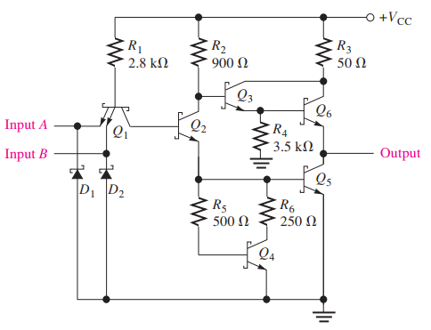
15.3. TTL (Bipolar) Circuits
Schottky TTL Most TTL logic is some form of Schottky TTL, which provides a faster switching time by incorporating Schottky diodes to prevent the transistors from going into saturation, thereby decreasing the time for a transistor to turn on or off.

Slide 25
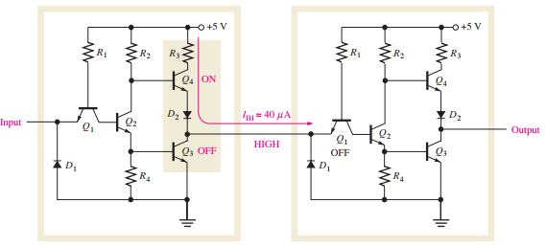
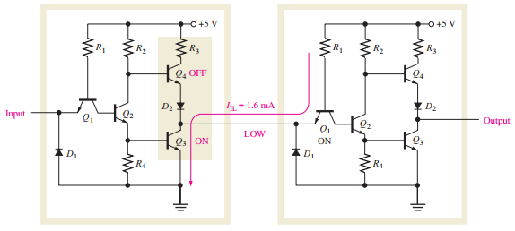
15.4. Practical Considerations in the Use of TTL
Current Sinking and Current Sourcing Current sinking and sourcing action in TTL

Slide 26
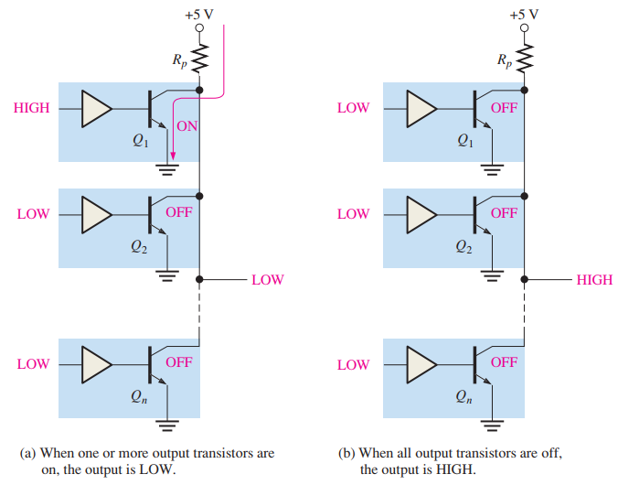

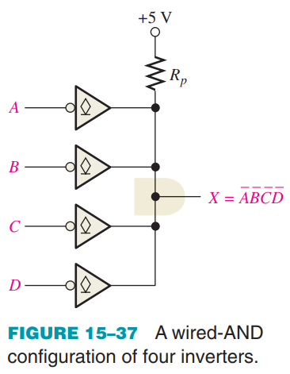
15.4. Practical Considerations in the Use of TTL
Using Open-Collector Gates for Wired-AND Operation

Slide 27
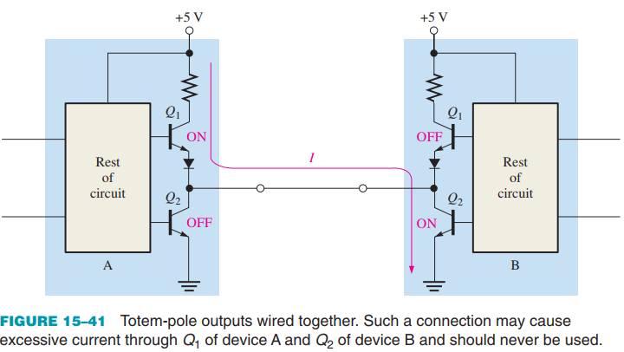
15.4. Practical Considerations in the Use of TTL
Open-Collector Buffer/Drivers A TTL circuit with a totem-pole output is limited in the amount of current that it can sink in the LOW state (IOL(max)) to 16 mA for standard TTL and 8 mA for LS TTL

Slide 28
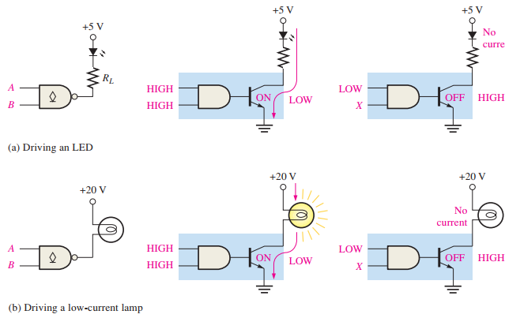
15.4. Practical Considerations in the Use of TTL
Open-Collector Buffer/Drivers With an open-collector TTL gate, the collector of the output transistor is connected to an LED or incandescent lamp, as illustrated in Figure 15–42. In part (a) the limiting resistor, RL, is used to keep the current below maximum LED current.

Slide 29
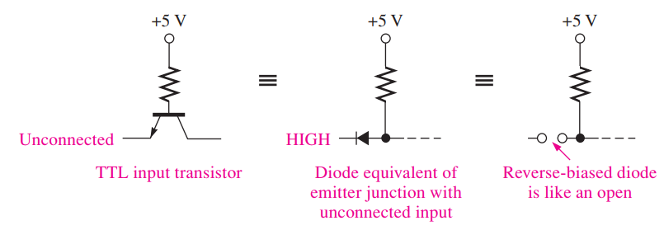
15.4. Practical Considerations in the Use of TTL
Unused TTL Inputs An unconnected input on a TTL gate acts as a HIGH because an open input results in a reversebiased emitter junction on the input transistor, just as a HIGH level does

Slide 30
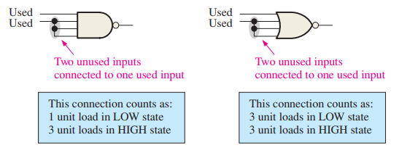
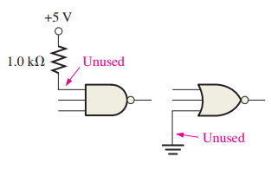
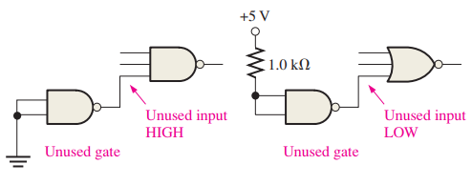



15.4. Practical Considerations in the Use of TTL
Unused TTL Inputs Inputs to Vcc or Ground: Unused inputs of AND and NAND gates can be connected to Vcc through a 1.0 k resistor. This connection pulls the unused inputs to a HIGH level. Unused inputs of OR and NOR gates can be connected to ground.

Slide 31
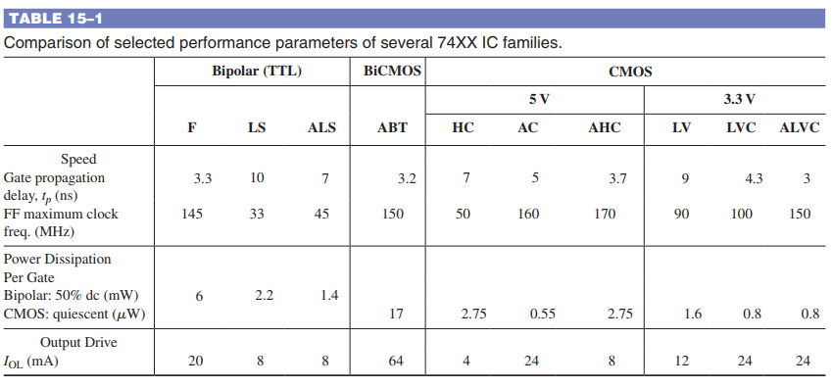
15.5. Comparison of CMOS and TTL Performance
One family of IC logic devices, BiCMOS, combines CMOS logic with TTL output circuitry in an effort to combine the advantages of both.

Slide 32
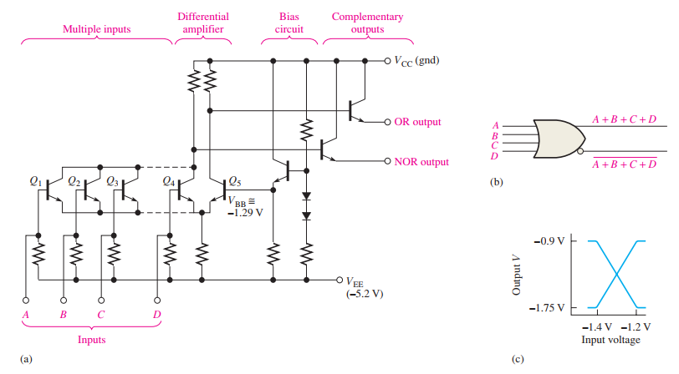

15.6. Emitter-Coupled Logic (ECL) Circuits
An ECL OR/NOR gate The emitter-follower outputs provide the OR logic function and its NOR complement

Slide 33
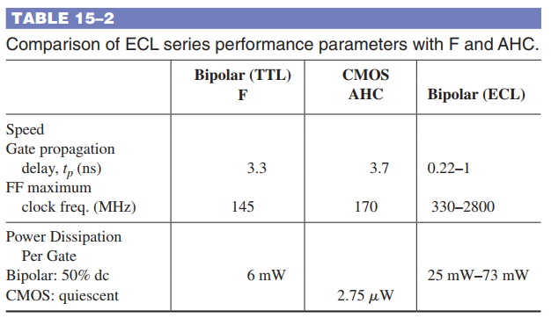
15.6. Emitter-Coupled Logic (ECL) Circuits
Comparison of ECL with TTL and CMOS

Slide 34
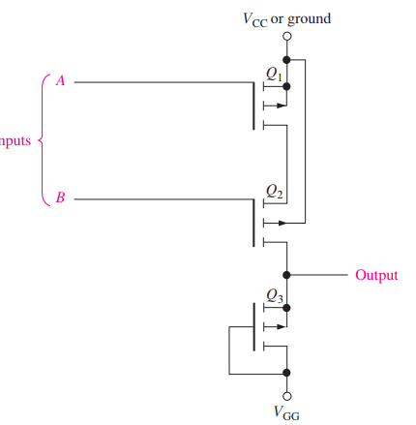

15.7. PMOS, NMOS, and E²CMOS
PMOS One of the first high-density MOS circuit technologies to be produced was PMOS. It utilizes enhancement mode p-channel MOS transistors to form the basic gate building blocks.

Slide 35
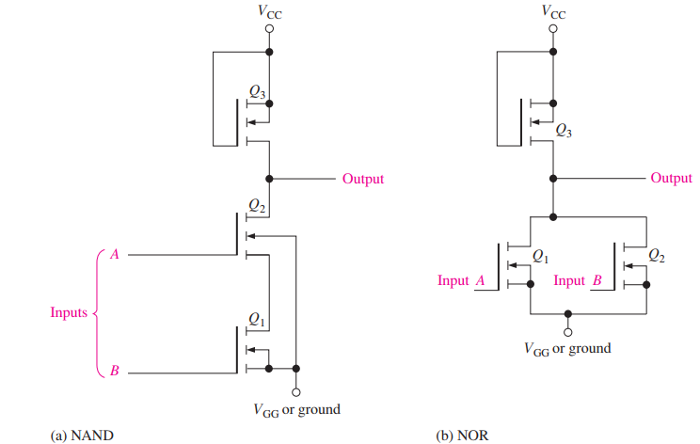
15.7. PMOS, NMOS, and E²CMOS
NMOS The NMOS devices were developed as processing technology improved. The n-channel MOS transistor is used in NMOS circuits.

Slide 36
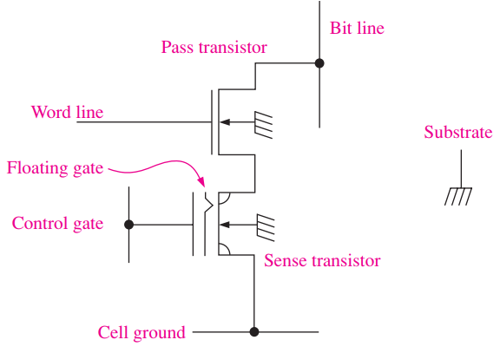

15.7. PMOS, NMOS, and E²CMOS
E²CMOS E2CMOS (electrically erasable CMOS) technology is based on a combination of CMOS and NMOS technologies and is used in programmable devices such as PROMs and CPLDs.

Slide 37
SUMMARY
Chapter 15: Integrated Circuit Technologies
Bb Totem-pole outputs of TTL cannot be connected together.
Open-collector and open-drain outputs can be connected for wired-AND.
CMOS devices offer lower power dissipation than any of the TTL series.
A TTL device is not as vulnerable to electrostatic discharge (ESD) as is a CMOS device.
Because of ESD, CMOS devices must be handled with great care.
ECL is the fastest type of logic circuit.
E²CMOS is used in PROMs and other PLDs.

Slide 38
MULTIPLE-CHOICE TEST AND PROBLEMS
Complete the true/false questions, multiple-choice questions, and end-of-chapter exercises in the primary textbook.

